Slide 1


E-commerce Sales Performance Analysis
This presentation offers an in-depth analysis of E-commerce sales data through a Power BI dashboard. It provides valuable insights that empower business stakeholders to make informed decisions, highlighting key performance indicators, trends, and actionable strategies for enhancing sales performance.

Slide 2


Executive Summary: Business Intelligence Dashboard Development
Objective
Methodology
Outcome
Transform raw transactional data into a business intelligence dashboard to enable strategic insights and decision-making.
Employed a four-stage process including Data Modeling, KPI Development, Interactive Dashboard Visualization in Power BI, and Predictive Analysis.
A comprehensive tool detailing performance metrics and projections to guide management strategies.

Slide 3
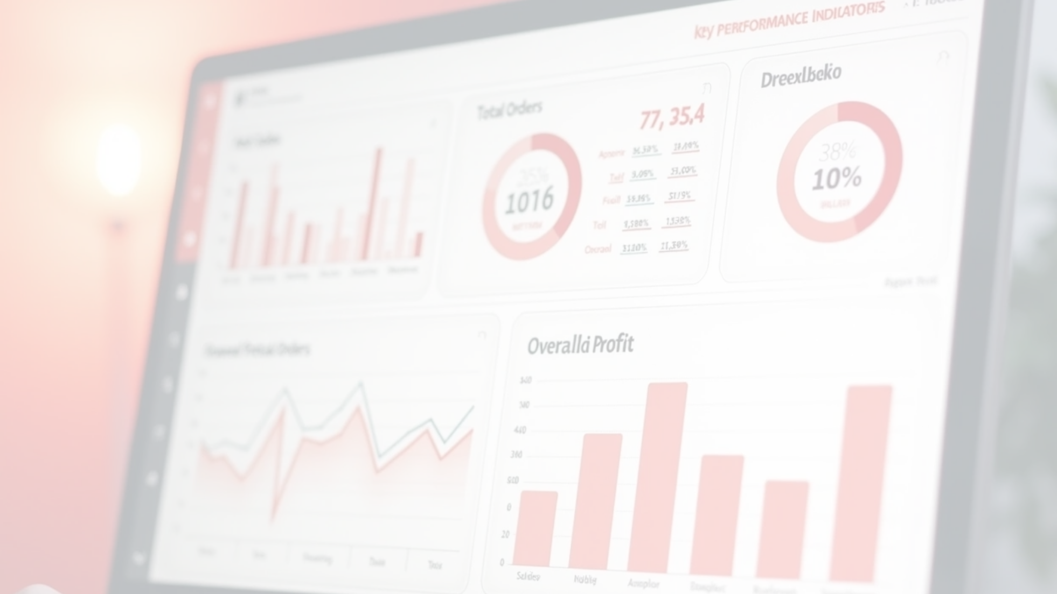
Executive KPI Dashboard Overview
4.42 billion
36.9k
5 billion
Net Sales
Total Orders
Profit
The total revenue generated from sales.
The total number of orders received.
Overall profit generated from operations.

Slide 4


Performance Analysis: Sellers, Products & Categories
This analysis highlights the detailed breakdown of sales by sellers, product types, and categories, enabling a comprehensive understanding of performance metrics.
Sales Breakdown
Revenue Insights
Volume Analysis
Analyzes sales performance by top sellers, individual products, and product categories.
Identifies key drivers of sales, helping to understand which products and sellers are performing well.
Offers detailed insights into volume trends across different segments for targeted strategies.

Slide 5





Strategic Customer Segmentation with RFM Analysis
1
2
3
RFM Model Implementation
Key Segments
Targeted Strategies
Segments customers based on Recency, Frequency, and Monetary value.
Highlights profitable segments like 'Champions' and 'Loyal Customers'.
Enables tailored marketing efforts for maximum engagement.

Slide 6




Predictive Analytics: 12-Month Sales Forecast
2
Data-Driven Insights
Provides companies with insights into potential revenue trends to guide planning and inventory decisions.
Forecast Methodology
1
Utilizes a time-series analysis to predict net sales over the next year.
Seasonal Considerations
Incorporates historical data and seasonality, enabling better preparedness for fluctuating demand.
3

Slide 7


Strategic & Actionable Recommendations
Retention Strategy
Proposes a re-engagement campaign targeted at 'At Risk' customers to reduce churn.
Loyalty Program
Suggests developing a rewards program for 'Champions' to increase customer lifetime value through enhanced loyalty.
Inventory Optimization
Recommends adjusting stock levels based on sales forecasts to minimize stock-outs and associated costs.

Slide 8
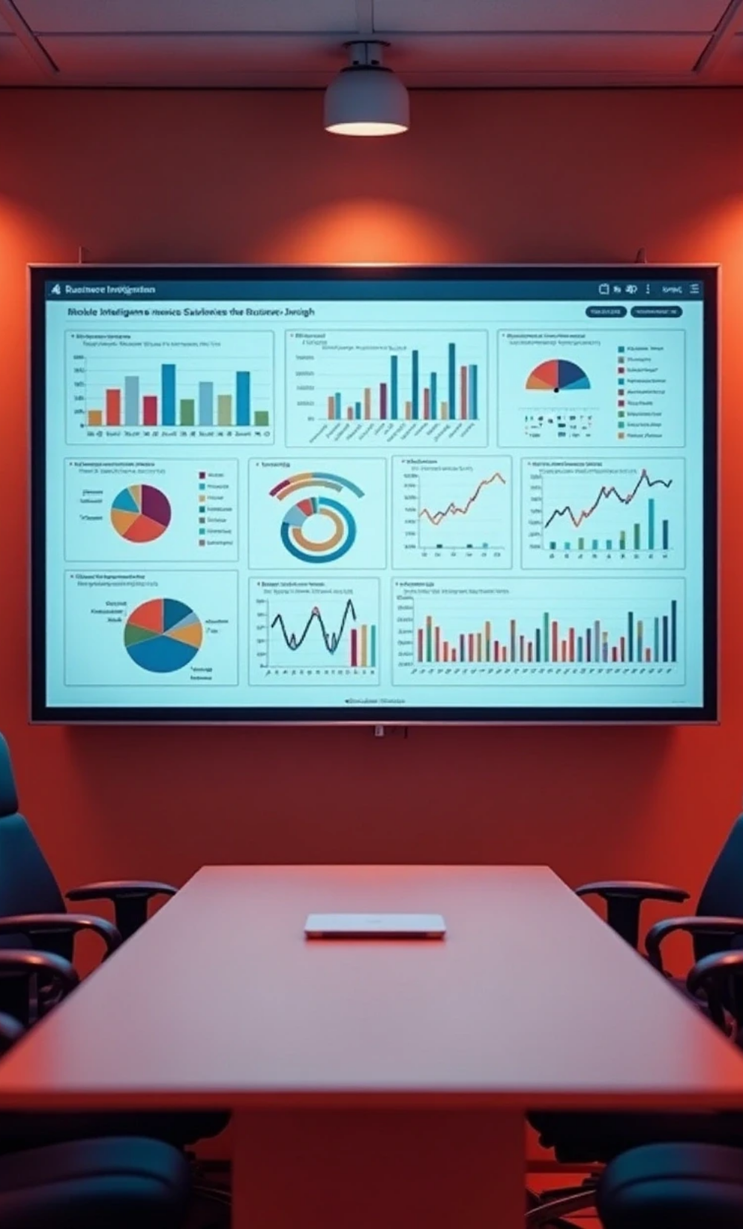



Conclusion & Next Steps
1
Project Impact
Successfully delivered a BI tool that simplifies complex data into strategic business insights.
2
360-Degree View
The dashboard equips management with a comprehensive view for proactive decision-making.
3
Q&A Session
Open floor for questions to clarify insights and discuss potential actions based on the analysis provided.

